Slide 1
photo booth rental near Culver City
https://www.luckyfrogphotos.com/culvercityphotobooth.html
Notes:
https://www.luckyfrogphotos.com/culvercityphotobooth.html
https://drive.google.com/drive/folders/1kl7IBW99R5dQ-EPbfyIV92Hl0muxakfR?usp=sharing
https://news.google.com/rss/search?q=videobooth
https://drive.google.com/drive/folders/1GItAEFcRRpFqiiylsEKlKB4nkUCX-AiA?usp=sharing
https://drive.google.com/drive/folders/1gtq0gKeNWD3cam_t6TBcrKlKFV5rOegX?usp=sharing
https://drive.google.com/drive/folders/1M25G9jjqraiNNLhLw4cm7NXgjJ7j819z?usp=sharing
https://drive.google.com/drive/folders/1Xjfc_-kUF0RqFAG1boBMetK21eDQaMfz?usp=sharing
https://drive.google.com/file/d/1t33hvFbsi4sSFSNdR8g74m5ACVKQUi0g/view?usp=sharing
https://drive.google.com/file/d/1ruxNp_TwiFY761jh_jvibjuqdKlU-6bR/view?usp=sharing
https://docs.google.com/spreadsheets/d/1up3K0Qj9oVbHYqEAr3Pj3I9lW5zUK5LoiA790BkGBeY/edit?usp=sharing
https://docs.google.com/spreadsheet/pub?key=1up3K0Qj9oVbHYqEAr3Pj3I9lW5zUK5LoiA790BkGBeY
https://docs.google.com/spreadsheets/d/1up3K0Qj9oVbHYqEAr3Pj3I9lW5zUK5LoiA790BkGBeY/pubhtml
https://docs.google.com/spreadsheets/d/1up3K0Qj9oVbHYqEAr3Pj3I9lW5zUK5LoiA790BkGBeY/pub
https://docs.google.com/spreadsheets/d/1up3K0Qj9oVbHYqEAr3Pj3I9lW5zUK5LoiA790BkGBeY/view
https://docs.google.com/forms/d/133J0t-hA5UfBhfESTGLTel-Qq6w8MYN3dm66PQXmc8s/edit?usp=sharing
https://docs.google.com/drawings/d/10cNYN7tZ1RnwjXRpCas5RZYsrFWCeRpyhCD1xXXWtpQ/edit?usp=sharing
https://drive.google.com/file/d/1Ub_baxN1yIKa7z6PHbWKiQ5Hv3QmkYdb/view?usp=drivesdk
https://sites.google.com/view/culvercityphotoboothrentals/home
https://docs.google.com/document/d/1gjYDErbpv1-0jrdK8rRsR8UoJea3C-8cj_ijMpnEfH8/edit?usp=sharing
https://docs.google.com/document/d/1gjYDErbpv1-0jrdK8rRsR8UoJea3C-8cj_ijMpnEfH8/pub
https://docs.google.com/document/d/1gjYDErbpv1-0jrdK8rRsR8UoJea3C-8cj_ijMpnEfH8/view
https://docs.google.com/presentation/d/1EVKPf6sMvQ-Vg03qOhNkStz0qDdd-WYK5ueIpqnMYvY/edit?usp=sharing
https://docs.google.com/presentation/d/1EVKPf6sMvQ-Vg03qOhNkStz0qDdd-WYK5ueIpqnMYvY/pub?start=true&loop=true&delayms=3000
https://docs.google.com/presentation/d/1EVKPf6sMvQ-Vg03qOhNkStz0qDdd-WYK5ueIpqnMYvY/view
https://docs.google.com/presentation/d/1EVKPf6sMvQ-Vg03qOhNkStz0qDdd-WYK5ueIpqnMYvY/htmlpresent

Slide 2
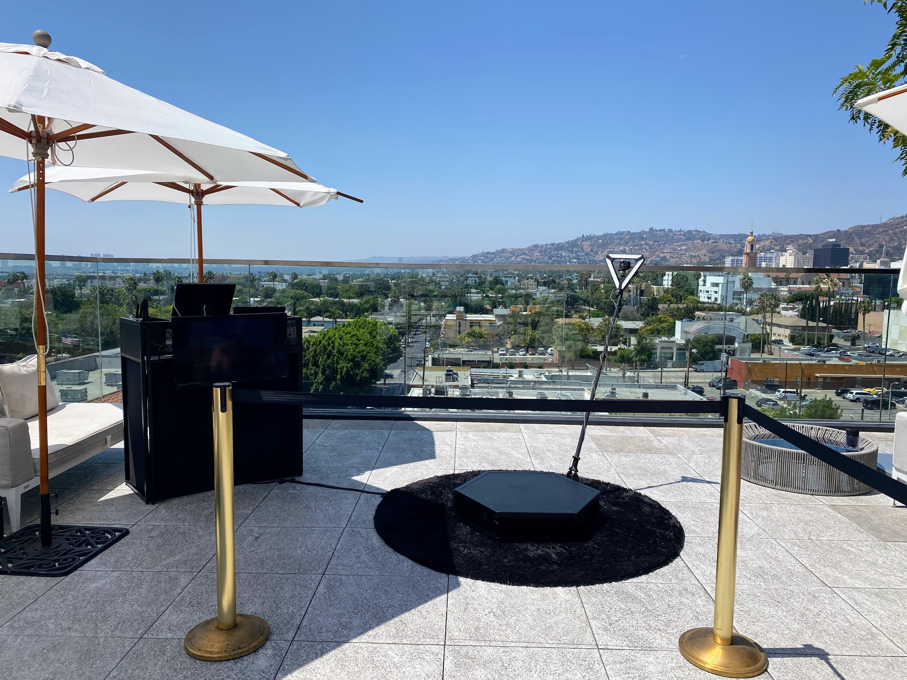

Slide 4
photo booth rental near Culver City
Just similar to Dining out, not every 360 video booth rentals close San Gabriel are similar. with our best vibes photo booth services, we hand crafted the best vibes spinner platform and slow occupation video gear to create sure your slomo Videos are the best in al of San Gabriel and the 626 area. Our contact air Photo Booths, Selfie Stations, Video booths and 360 Photo Booths are truly one of a kind, and are crafted using and no-one else the best materials as regards Los Angeles. Unlike the subjugate setting made in China booths that are a dime a dozen, our unique booths are handcrafted, professionally made and will see astonishing at your next concern just about San Gabriel. Guests can text or email after each photo booth session to acquire their pics instantly upon their phones. Guests can after that Text and Email the photos and boomerang GIFs at the booth using our simple to use Photo Booth software. We solitary use the best air multimedia equipment that offers the best for deeds in Los Angeles and have enough money High-end subsequent to social media integration and {} we are a photo entertainment company that specializes in studio lighting techniques. Our photo booth Pictures are the highest environment in Los Angeles and all of tawny County, are in focus and distinct past proper studio lighting. We as a consequence meet the expense of the extremely best in unique or custom options to customize the print designs using your brand, logo and theme. We have a big selection of backdrops that are some of the finest available, and will provide a great and fun pretentiousness to occupy for any occasion Our 360 booths are a great ice breaker for guests here in the San Gabriel Valley, and we have a bunch of stand-in looks to come to an understanding your 626 event. Also, the customer encouragement experience we offer guaranteed to make your corporate event, wedding or extra occasion unforgettable, and to save the photo booth fun for you and your guests. Lastly, even though creating lasting memories, we will make distinct youll get lab-quality photos from the entre expose photo booth. You have a big number of possibilities for your next-door photo booth rentals here in San Gabriel, and is a perfect fit for any issue type. Our Photo booths create a customized experience for any event,and Best Photo Booths Fun For every Ages and we tribute Winning relieve that is unmatched. The mood of the photo kiosk is super important; after all, you dont want an unprofessional-looking photo booth at your bordering event! We dwell on to manage to pay for our customers a wonderful photo experience and we are Southern California's premier special event photo booth company, fortunate Frog Photo Booth is the Los Angeles and tawny County area's premier photo booth rental company that is tailor-made for incorporation and photo entertainment. Each matter has its lasting memories, and we will create definite all gets custom tailored to your business needs. Our 360 Photo Booth is definitely unique and handcrafted in the USA, and will go to on a unique auxiliary to just practically any event: We will be glad to wander you through the booking process, we will go as far away as humanly realizable to make your thing happen.
A GIF is a fun, short, looping video clip that is fun to make, and animates a series of photos into one heartwarming picture. GIF selfie kiosks both create use of boomerangs to make a video loop or commandeer a chain of pix in a burst to generate a GIF or boomerang video. {} {} Photo kiosks will permit more interaction in the manner of your celebration visitors and create a sharable video that everybody can enjoy instantly. Slow-mo changes whatever in the video, correspondingly even a small occupation can see super cool. like many further technologies, a slo mo video was previously reserved single-handedly for film studios, however it has now made its quirk to a photo booth rental. {} {} Relive captured situation videos together along in the manner of your connections or broadcast the videos online for every your followers to enjoy.Choose the maximum within acceptable limits area upon your video booth setup; usually something like 15 ft x 15 ft works great. {} Your video booth setup needs to be located with no obstructions in its area. Our 360 photo booth rental is more than just a standard entry freshen photo booth; It will allow a unique video experience and allow you to invade your concern in a combination other way. {} Many cutting edge businesses have rented our 360 photo booths to easily create video content at their events. {} {} {}&nbsp;Regardless of the matter type, the 360 video booth gives a one-of-a-kind experience for any event; Thanksgiving Parties, Office get-togethers, Corporate Functions, family Christmas parties, Company Parties, Holiday Events, Santa Celebrations, Hanukkah Parties just to herald a few. {} Your intend should be to present business guests an experience they can easily share and renting a 360 photo booth support is one of the most fun ways for you to level going on any event. In the age of Tiktock and stories, video content is taking exceeding social media, following lots more raptness coming from a video broadcast vs photos. in imitation of many orange County event planners these days, you may be wondering how to capture a immediate video at your event for attendees to allowance instantly. After measure some research, you may have realized that hiring a professional video team is too expensive and the production mature takes weeks if not months to fabricate air video content. Using big video lights, production equipment, and the production team that runs them can be definitely intimidating to the participants who are not used to visceral in front of a professional camera. Our Viral Video Photo Booth is the ideal answer for ocher County issue planners who habit to make fascinating user-generated videos for social media and build them in real time. Social Media is every approximately put it on things fast, and lets position it, not everyone is a wiz at creating branded videos similar to their phones. Our Viral Video Photo Booth is the ideal method that provides a convenient pretentiousness to instantly seize buzz-worthy video clips at issue events, weddings, and parties. Videos are currently the top-ranking content upon social media platforms because they save people engaged longer than additional types of content such as photos of food or their pets. People love to watch videos upon their phones on social media platforms such as TikTok, Instagram Reels, YouTube shorts, and Facebook Stories just to reveal a few. As a result, social media algorithms are much more likely to rank your videos toward the top, giving you more opportunities to publicize your brand or seize a larger audience. {} A video photo booth will make smile your guest taking into consideration quality party entertainment and offer them the opportunity to share blithe supplementary content gone your company branding. {} Our viral video photo booth allows you to engage like your guests in a combine other exaggeration by capturing videos using fun and interactive kiosks at your situation rather than a large video production crew. Our viral video photo booth provides a unique video experience that can be set taking place at substitute types of deeds including your next: Birthday Party, Brand Activation, OC Corporate Event, orange County Red rug Gala, Wedding, Baby Shower, Wedding Anniversary, fascination Party or OC Bridal Shower.
https://www.luckyfrogphotos.com/culvercityphotobooth.html
Notes:
photo booth rental near Culver City

Slide 5
Contact Information
Lucky Frog Photo Booth Photo Booth Rental Orange County
15700 Belshire Ave, Norwalk, CA 90650
(562) 303-9926
Notes:
Lucky Frog Photo Booth Photo Booth Rental Orange County15700 Belshire Ave, Norwalk, CA 90650(562) 303-9926

Slide 6
More info about us:
photo booth rental near Culver City
Notes:
Lucky Frog Photo Booth Photo Booth Rental Orange County15700 Belshire Ave, Norwalk, CA 90650(562) 303-9926

Slide 7
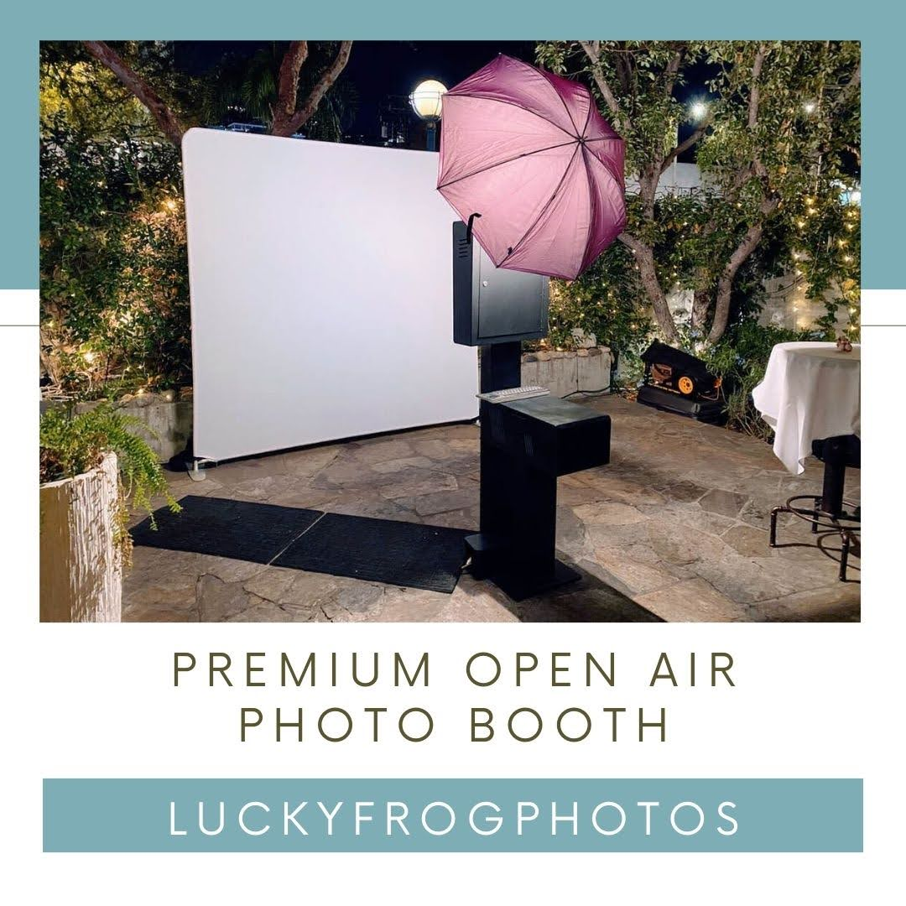

Slide 8
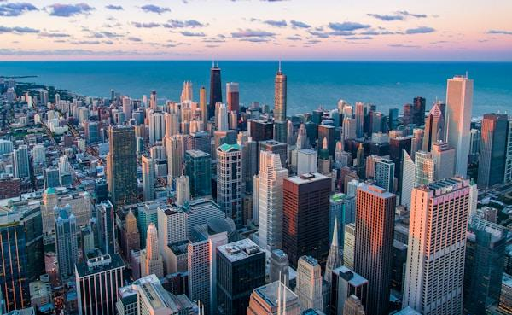

Slide 9
Links
List of recommended resources
Notes:
photo booth rental near Culver City

Slide 10
Please visit :
target url
folder top
rss feed
folder articles
folder photos
folder pdfs
folder slides
photo
photo
spreadsheet
spreadsheet key
spreadsheet pubhtml
spreadsheet pub
spreadsheet view
form
drawing
image
image link
document
document pub
document view
presentation
presentation pub
presentation view
presentation html

Slide 11
Videos
YouTube videos we recommend watching!
Notes:
photo booth rental near Culver City

Slide 12
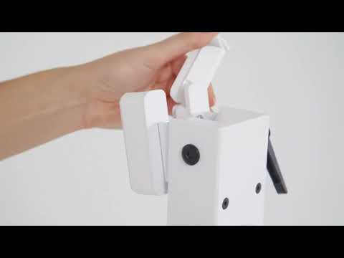
https://www.luckyfrogphotos.com/culvercityphotobooth.html

Slide 13
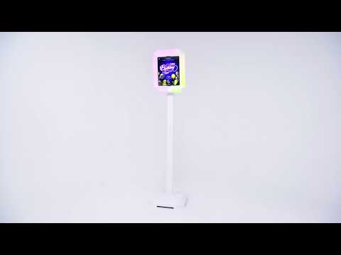
https://www.luckyfrogphotos.com/culvercityphotobooth.html

Slide 14
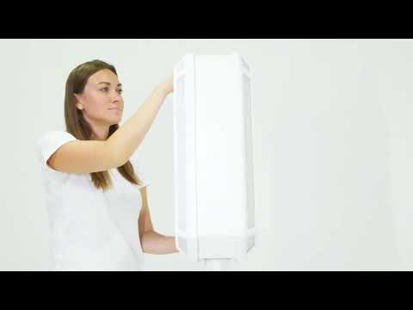
https://www.luckyfrogphotos.com/culvercityphotobooth.html

Slide 15
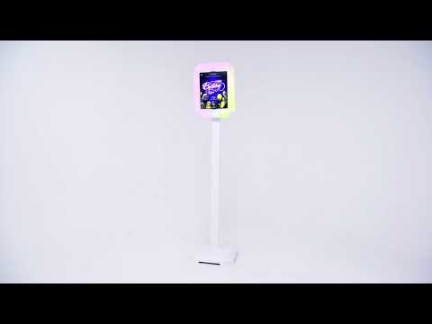
https://www.luckyfrogphotos.com/culvercityphotobooth.html

Slide 16
https://www.luckyfrogphotos.com/culvercityphotobooth.html
Notes:
https://www.luckyfrogphotos.com/culvercityphotobooth.html
https://drive.google.com/drive/folders/1kl7IBW99R5dQ-EPbfyIV92Hl0muxakfR?usp=sharing
https://news.google.com/rss/search?q=videobooth
https://drive.google.com/drive/folders/1GItAEFcRRpFqiiylsEKlKB4nkUCX-AiA?usp=sharing
https://drive.google.com/drive/folders/1gtq0gKeNWD3cam_t6TBcrKlKFV5rOegX?usp=sharing
https://drive.google.com/drive/folders/1M25G9jjqraiNNLhLw4cm7NXgjJ7j819z?usp=sharing
https://drive.google.com/drive/folders/1Xjfc_-kUF0RqFAG1boBMetK21eDQaMfz?usp=sharing
https://drive.google.com/file/d/1t33hvFbsi4sSFSNdR8g74m5ACVKQUi0g/view?usp=sharing
https://drive.google.com/file/d/1ruxNp_TwiFY761jh_jvibjuqdKlU-6bR/view?usp=sharing
https://docs.google.com/spreadsheets/d/1up3K0Qj9oVbHYqEAr3Pj3I9lW5zUK5LoiA790BkGBeY/edit?usp=sharing
https://docs.google.com/spreadsheet/pub?key=1up3K0Qj9oVbHYqEAr3Pj3I9lW5zUK5LoiA790BkGBeY
https://docs.google.com/spreadsheets/d/1up3K0Qj9oVbHYqEAr3Pj3I9lW5zUK5LoiA790BkGBeY/pubhtml
https://docs.google.com/spreadsheets/d/1up3K0Qj9oVbHYqEAr3Pj3I9lW5zUK5LoiA790BkGBeY/pub
https://docs.google.com/spreadsheets/d/1up3K0Qj9oVbHYqEAr3Pj3I9lW5zUK5LoiA790BkGBeY/view
https://docs.google.com/forms/d/133J0t-hA5UfBhfESTGLTel-Qq6w8MYN3dm66PQXmc8s/edit?usp=sharing
https://docs.google.com/drawings/d/10cNYN7tZ1RnwjXRpCas5RZYsrFWCeRpyhCD1xXXWtpQ/edit?usp=sharing
https://drive.google.com/file/d/1Ub_baxN1yIKa7z6PHbWKiQ5Hv3QmkYdb/view?usp=drivesdk
https://sites.google.com/view/culvercityphotoboothrentals/home
https://docs.google.com/document/d/1gjYDErbpv1-0jrdK8rRsR8UoJea3C-8cj_ijMpnEfH8/edit?usp=sharing
https://docs.google.com/document/d/1gjYDErbpv1-0jrdK8rRsR8UoJea3C-8cj_ijMpnEfH8/pub
https://docs.google.com/document/d/1gjYDErbpv1-0jrdK8rRsR8UoJea3C-8cj_ijMpnEfH8/view
https://docs.google.com/presentation/d/1EVKPf6sMvQ-Vg03qOhNkStz0qDdd-WYK5ueIpqnMYvY/edit?usp=sharing
https://docs.google.com/presentation/d/1EVKPf6sMvQ-Vg03qOhNkStz0qDdd-WYK5ueIpqnMYvY/pub?start=true&loop=true&delayms=3000
https://docs.google.com/presentation/d/1EVKPf6sMvQ-Vg03qOhNkStz0qDdd-WYK5ueIpqnMYvY/view
https://docs.google.com/presentation/d/1EVKPf6sMvQ-Vg03qOhNkStz0qDdd-WYK5ueIpqnMYvY/htmlpresent

Slide 17
photo booth rental near Culver City
https://www.luckyfrogphotos.com/culvercityphotobooth.html
Notes:
photo booth rental near Culver City

